Slide 1
Introduction to Python
Ammon Perkes
BIOL 437 / GCB 536 / …
September 5, 2018
Notes:
Pronunciation optional
Who's had some experience with python?
Sit by each other!

Slide 2
Overview
1. Using python
2. Variables and data types
3. Logical statements (if-else)
4. Loops
5. Lists
6. Application: String Matching
https://xkcd.com/353/
Notes:
Caveats:
I'm no expert in Python, nor in python teaching, so stop me if you have questions!
Rework this to focus on the task “7” in “12350987346”

Slide 3
1. Using python: Three Approaches
Use the Interpreter
Quickly see the results of a single line of code
Great for quickly testing small pieces
Using scripts
Easily re-run the same code (important for longer blocks)
Share your code with others
Interactive Notebooks like Jupyter or iPython
Best of both worlds, especially for demonstration
Easy learning curve, but requires some installation to set up
Text editing is not always as powerful as a text editor

Slide 4

1.1 Using python: The Interpreter
Simply type ‘python’ in the terminal/command line
The interpreter will immediately evaluate a line of code (unlike a script, which will not run until executed)
It remembers variables entered, making it great for testing small sections of code. (or as a programmable calculator). For longer code, the interpreter quickly becomes difficult to work with.

Slide 5


1.1 Using python: Using the Interpreter
Open your terminal
Type python
Type code and press enter to see the result
Because it remembers variables, you can also use the interpreter as a programmable calculator
Notes:
Some things to think about:
They might not know about variable names, what equals means, quotations for strings, etc. Lots of ways to raise errors here.
If you don’t have a mac, this might be a little trickier.
This is where I introduce int’s

Slide 6


1.2 Using Python: Create and run a script
Text editors make it easy to write, edit, and share code
Step 1: Create a script
Open a plain text editor (Notepad++, BBedit, etc. MS Word won’t work)
Type the following:
Save your file as test.py
Notice that, after saving, you likely have conditional highlighting
Notes:
Breeze through this also, I will only use jupyter.
For todays demonstration I’ll be using TextWrangler, which is free and works pretty well on Apple. I actually do everything in Vim, and I’d encourage you to check it out, but there’s a pretty steep learning curve.
Text Edit really doesn’t work here.

Slide 7
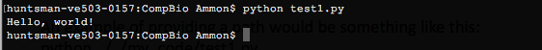
1.2 Using Python: Create and run a script
Step 2: Running the script
Open terminal and move to the correct directory (using cd to change directory and ls or dir (for OSX or windows, respectively) to list files/folders in the directory.
One you have found your script, type python test.py
Assuming there are no errors in the code you should see your code’s output:
Notes:
demonstrate

Slide 8

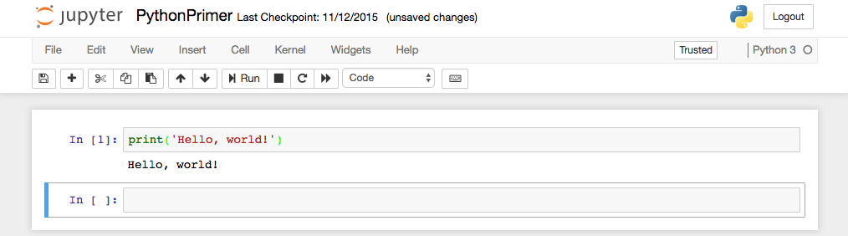
1.3 Using Python: Interactive Notebooks
Interactive notebooks like Jupyter or iPython can dramatically lower the learning curve and improve the experience of coding in Python
They allow you to run code in sections, similar to the interpreter, but make saving, editing, and sharing your finished code much easier
Notes:
The rest of the demonstrations I’ll be doing in either jupyter or textwrangler

Slide 9
1.4 Using Python: So what are we doing?
“function”
”argument” (in this case, a line of text, called a string
This is called a print statement
The print command outputs contents to the terminal screen
To print a line of text (called a string), it must be enclosed in quotations. This identifies the text as a string instead of as some other command.
Most commands are of the format command(arg)

Slide 10
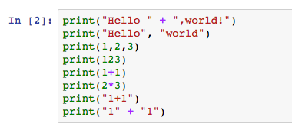
1.4 Using python: fun with printing
Try each of the following, in each one think about what print is doing
Tip: in terminal/command line you can press the up arrow to cycle through your history
Notes:
depending on the class, give people time to go through this. This will give people their first familiarity with python in a fairly safe setting, and will provide the foundation, both emotionally, socially, and mechanically for the more complex problems down the road. So take 5 minutes on this.. It will give you time to debug a lot of the issues now rather than later.
Point out that print behaves differently for 1+1 and “1+1”. This introduces the idea of strings and ints

Slide 11
2.1 Variables: Introduction
You can think of variables as boxes for temporarily storing data. We name the boxes so that we can use them again later.
Different languages operate differently, but variables must generally be defined (or declared) before being used. (Python is no exception, although it is quite flexible, making it comparatively easy)
Variable names can be almost anything, but certain words (e.g. print) are reserved for commands.

Slide 12
2.1 Variables: Introduction
For example:
myGene = “Fmr1”
Variable Name
“assignment operator”
Data (in this case a string)
This tells python: Store the value “Fmr1” in the box called myGene
Notes:
Try not to think of this as an equation. A single equal sign merely assigns a value. We’ll talk about double equal signs and equations later.

Slide 13
2.2 Variables: Naming Rules and Conventions
Rules (breaking these results in errors):
No spaces, no special characters. Use only letters, numbers, and underscores
Names cannot begin with a number (i.e. 7eleven won’t work)
You can’t use python-reserved words (i.e. print, int, if)
Names are case sensitive, so myGENE is a different variable than myGene
Conventions (this makes code easier to read):
Begin a variable with a lower case letter
Make names descriptive (myGene instead of mg)
If using multiple words, use camelCase or under_scores to make it easier to read
Notes:
I'm going to skip this slide this time, just tell people there are rules, but this isn't that important

Slide 14
2.2 Variables: good and bad examples
Good variable names:
geneID
personCount
Input_file
avgGeneCount
Bad variable names:
3rdColumn
tnisfnld
person#
class
Notes:
this is probably sufficient

Slide 15
2.2 Variables: good and bad examples
Good variable names:
geneID
personCount
Input_file
avgGeneCount
Bad variable names:
3rdColumn (illegal)
tnisfnld (gibberish)
person# (illegal)
class (reserved word)

Slide 16
2.3 Variables: Data types
Data comes in different types (numbers, characters, words, etc)
Variables work differently depending on the type of data they contain. We’ll mostly be working with a few data types:
String (str)- a string contains text. You can think of it as a series of individual characters, like beads on a string. Strings are enclosed in quotes to distinguish them from variables or commands. (“double” and ‘single’ quotes both work)
Integers (int) – Just like in math, integers are counting numbers (1,2,3,-1, etc).
Floating point numbers (float) – numbers with decimals. Be aware Ints and floats sometimes work differently: (in Python 2, 7/10 != 7/10.0)
Booleans (bool) – True or False (1 or 0). Used for logical operations (discussed in detail later)
Notes:
it might be worth pointing out, for people with no python experience (but with other programming experience) that python is very flexible in this regard

Slide 17
2.3 Variables: Data types
Variable type is determined when the variable is defined
So
myGene = “Fmr1” is a string
myGene = 8 is an int
myGene = 8.7 is a float
if you redefine a variable it will change its type
Notes:
Practice here too

Slide 18
2.4 Data Types: Boolean Variables
A boolean (or “bool”) is a type of variable, just like strings and ints, but it can only take one of 2 values: True or False
True and False are reserved words and must be capitalized
Try not to think of them as words, they’re interpreted by the computer as 1 and 0, respectively. (In fact you can use 1 or 0 in place of True or False)
Notes:
Do a bit of practice here

Slide 19
3.1 Logical Statements: if-else
Think of programming as a way to give your computer (extremely specific) instructions
Often we need to provide conditional instructions, e.g.
To get to the bus stop by bike:
If it’s before 6pm, stay north on 38th to chestnut, otherwise cut across campus after the crosswalk
When you get to chestnut, turn right, and continue until JFK.

Slide 20
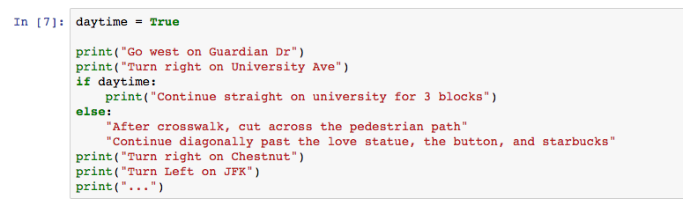
3.1 Logical Statements: if-else
In our instructions, the “if” “otherwise” provided a branch, depending on existing conditions.
We do this in python using if and else
In python, we would give the same instructions as
True and False are special words called Booleans
This is the if/else statement. depending on the condition (daytime) it determines which section to execute

Slide 21
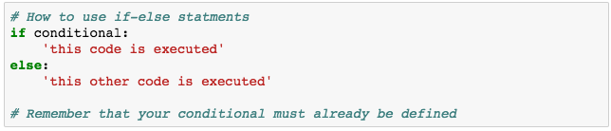
3.3 Logical Statements: Using if-else
Note the colon following the if and else statements
The spacing defines the if block (a good text editor is helpful here)

Slide 22
3.3 Logical Statements: Using if-else
Anything that can be evaluated as true or false can be used
is a True?
is a or b True?
is a equal to b?
is a greater than or equal to b?
is b less than a and greater than c?
is a equal to “ACGTAT”?
Notes:
Give an example of something that couldn’t be used

Slide 23
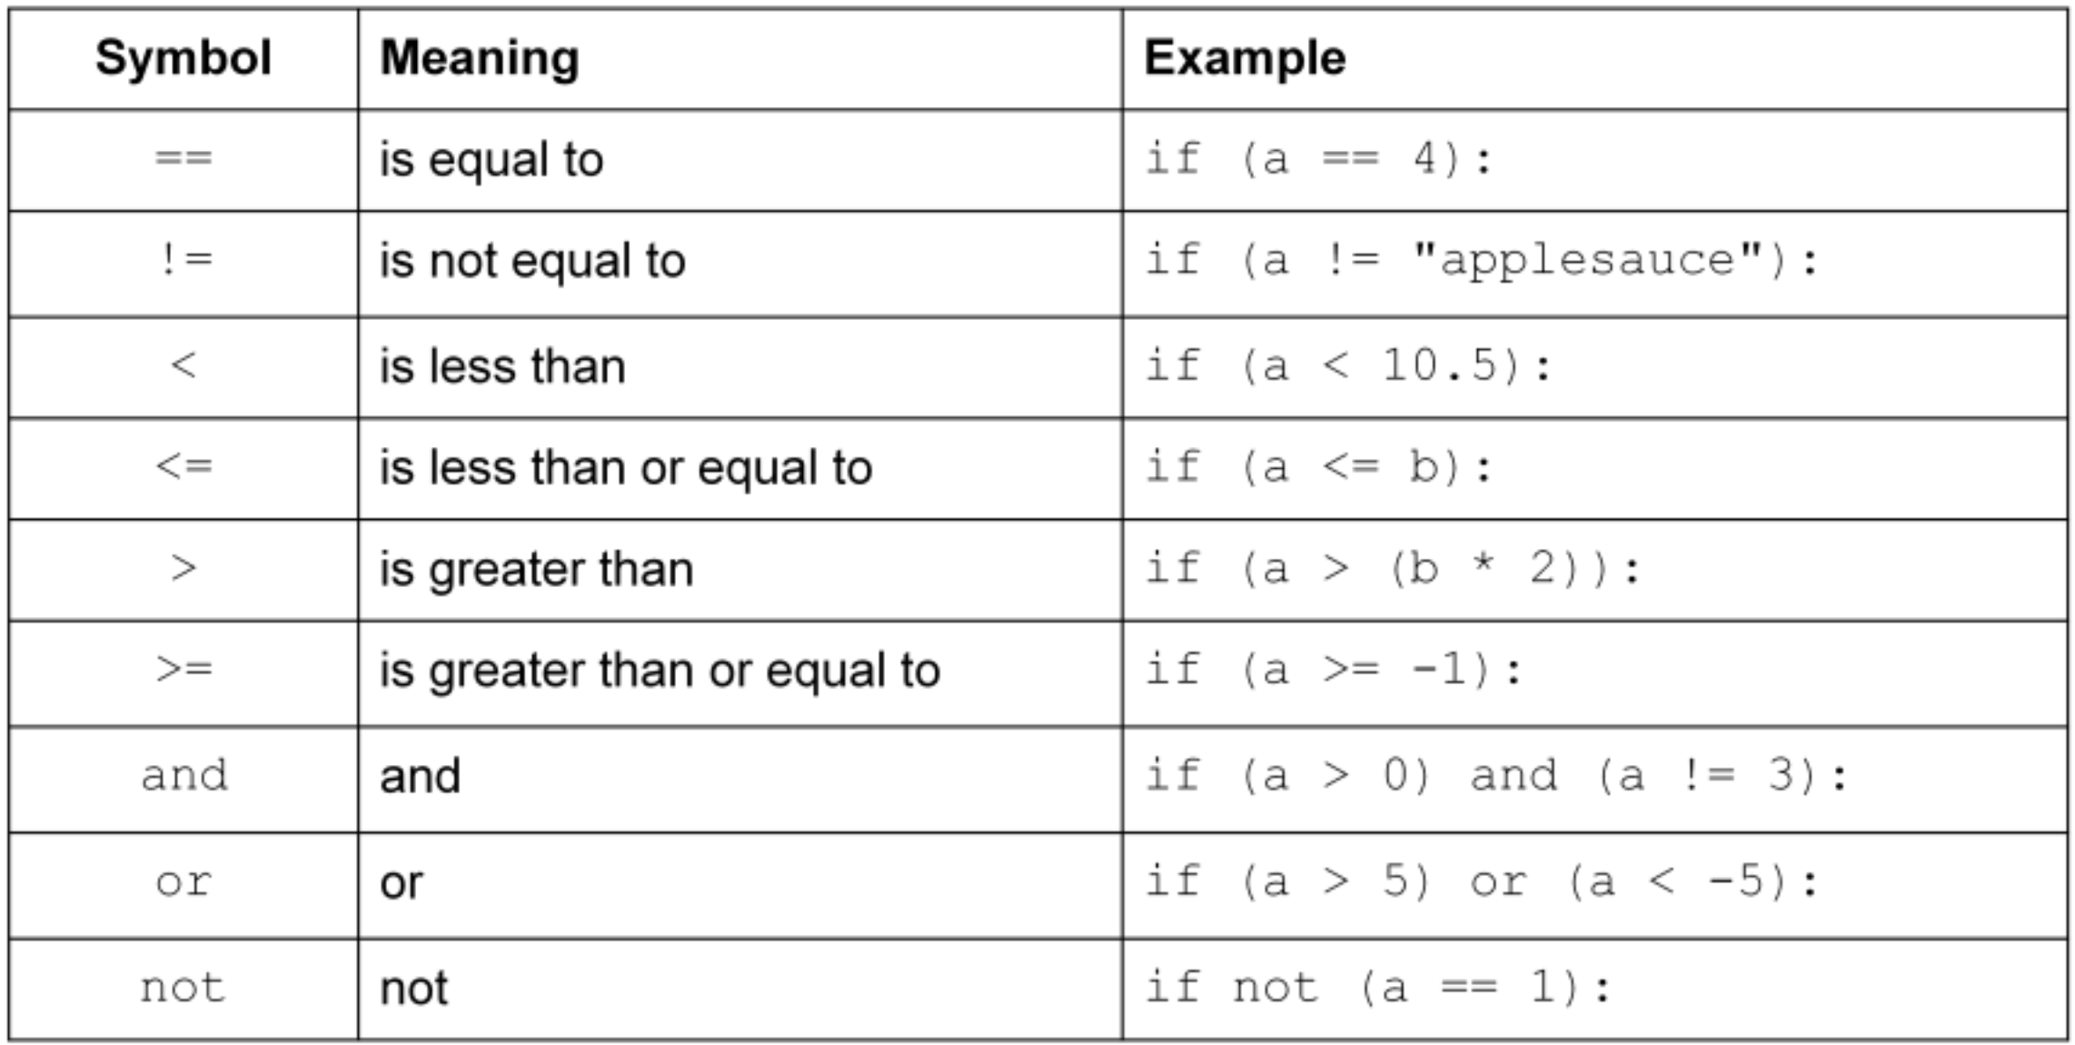
3.3 Logical Statements: Using if-else
Notes:
by the way, there’s an order of operations, but you’re better off using parentheses
(but it’s: is, in, not, and, or)

Slide 24
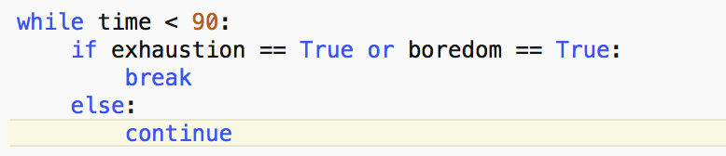
5 Minute Break, next up: for and while loops!

Slide 25
Overview
1. Using python
2. Variables and data types
3. Logical statements (if-else)
4. Loops
5. Lists
6. Application: String Matching
https://xkcd.com/353/

Slide 26
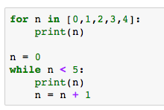
4.1 Loops: Intro to Loops
Loops provide a tool to repeat an action multiple times
Since programming almost always seeks to automate an otherwise exhaustive task, loops are one of the fundamental techniques
There are only two loop operations:
the for loop
the while loop

Slide 27
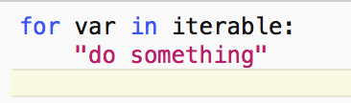
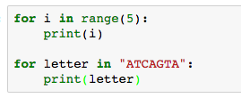
4.2 Loops: The for Loop
The for loop repeats an action a specified number of times
iterable: anything you can work through in discrete steps (iterate). Strings, lists, files all can be iterated
var takes on each value in the iterable (e.g. each letter in a string)
When there are no values left, the loop ends.

Slide 28
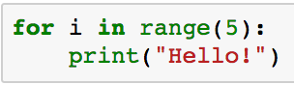
4.2 Loops: Using the for loop
One of the simplest ways to use a for loop is with the range function
Any iterable can be used
Notes:
head to jupyter

Slide 29

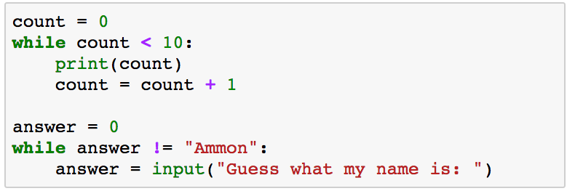
4.3 Loops: The while Loop
The while loop repeats an action an indefinite amount of times, based on some condition
while loops are useful when you aren’t sure how many times you will need to repeat an action
Beware of creating infinite loops!
If you’re code doesn’t seem to be doing anything (or if it’s printing endlessly) hit CTRL-C to quit (or stop in Jupyter)

Slide 30
4.3 Loops: Using the while loop
Waiting for correct input from user
Counting calculations (e.g. How many times can you divide 100 by 2?)
Search until successful
Anytime your loop length is unknown
Watch out for endless loops! (Remember CTRL-C)
Notes:
head to jupyter

Slide 31
4.4 Loops: for vs while
Use for when:
number of steps is known
you want to go through all of the steps
Use while when:
number of steps required is unknown
you can stop once the condition is met
Loops often take the bulk of your run time, beware of inefficiencies within for loops.
In while loops (but not in for loops) you can create an infinite loop

Slide 32
5.1 Lists: Intro to Lists
A list is a built-in data structure in Python (i.e. a way of storing a series of data points)
Lists are denoted with brackets ( mylist = [“thing 1”, “thing 2”] )
Lists can be composed of anything (numbers, words, objects, other lists) and can be mixed ( [ 1, “cat”, [1,2,3], False] )
You can use any list in for loops

Slide 33
5.2 Lists: Using Lists
Lists are indexed, starting at 0
lists are accessed using listName[index]
mylist = [ “cat”, False, “Ammon”, 204, 2.75 ]
0 | 1 | 2 | 3 | 4
‘cat’ | False | Ammon | 204 | 2.75
myList:
myList[0]
myList[1]

Slide 34
5.2 Lists: Creating lists
Empty lists
myList = []
List of elements:
myList = [“cat”, “fish”, “dog”]
Quickly make lists of numbers using range:
myList = list(range(5,100,10))
Notes:
this is where we go to jupyter

Slide 35
5.3 Strings as lists
Strings can be indexed and iterated just like lists
myString = ‘This is a string’
myString[5] = ’i’
myString[0:6] = ‘This i’
for letter in myString:
print(letter)
Notes:
Here, we can tie everything together on our example problem!

Slide 36
7.1 Learning Python
Practice!
Read supplemental materials
Use Google, watch YouTube videos, ask real humans for help
Notes on debugging
Read your error message, note the line that’s causing problems
Google (you can google your error message for explanations on why it broke)
Use print to check values before it breaks
Walk through code in interpreter
Write out code
Use proper debugging tools (pbd, others)

Slide 37
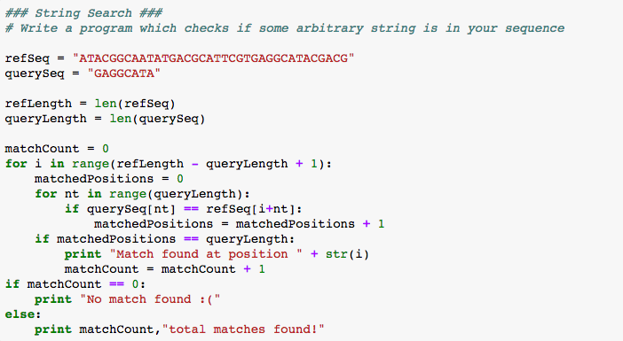
6.1 Application: String Matching
Check if some arbitrary section is found in your reference DNA
refSeq = "ATACGGCAATATGACGCATTCGTGAGGCATACGACG”
querySeq = "GAGGCATA”
Notes:
Ask them to think about it first, then go through it on the board, then in code (see how time goes, this whole thing will take around 15 minutes)

